Slide 1
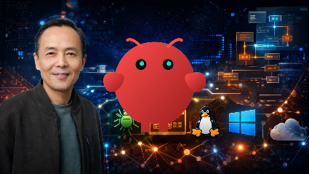

AI Reverse Engineering with OpenClaw & MCP
Hi — I’m Dr. Paul Chin. Welcome to AI Reverse Engineering with OpenClaw & MCP.
Reverse engineering is changing.
For decades, reverse engineers have relied on powerful tools such as debuggers, disassemblers, and decompilers. But no matter how advanced the tools became, the analyst still had to perform most of the work manually. Today, a new approach is emerging. By combining Large Language Models, the Model Context Protocol—or MCP—and OpenClaw, we can create AI-powered workflows where intelligent agents interact directly with reverse engineering tools and help automate complex analysis tasks.
In this course, you'll learn how to connect AI to real reverse engineering tools, enabling it to inspect binaries, gather information, analyze results, and assist you throughout the reversing process.
This is much more than simply asking ChatGPT to explain assembly code.
You'll learn how OpenClaw acts as the orchestrator, how MCP acts as the bridge between AI and tools, and how multiple tools can work together as part of a coordinated reverse engineering workflow.
Whether you're a reverse engineer, malware analyst, ethical hacker, penetration tester, or simply curious about the future of AI-driven cybersecurity, this course will give you a practical introduction to the next generation of reverse engineering. AI is no longer just a helper.
It can become a collaborator, a tool operator, and a workflow orchestrator.

Slide 2
What you will learn
What is Model Context Protocol (MCP) and how it connects AI to tools
What is OpenClaw and how it enables multi-tool workflows
How AI agents remember workflows
Connecting AI to Debuggers
Prompt engineering for binary analysis
How to easily FIX OpenClaw issues
Managing different AI Models
Using Codex and Claude Code with OpenClaw
Dynamic and static analaysis
Connecting OpenClaw to x64dbg, ghidra and dnSpy using MCP
Using OpenClaw to interpret assembly code to derive serial key
Using OpenClaw to create keygens, bypass Trial Period, disable Nags
And more . . .

Slide 3
Who this course is for
Reverse engineers who want to increase their productivity by using AI
Malware analysts looking to automate workflows
Ethical hackers and pentesters exploring AI-driven tooling
Developers curious about multi-tooling AI systems
Anyone interested in AI + cybersecurity integration using OpenClaw

Slide 4

Prerequisites
Familiarity with tools like debuggers or disassemblers (helpful, not required).
No prior AI experience needed — you’ll learn everything step-by-step
Windows PC running Windows 11 in Oracle VirtualBox.

Slide 5
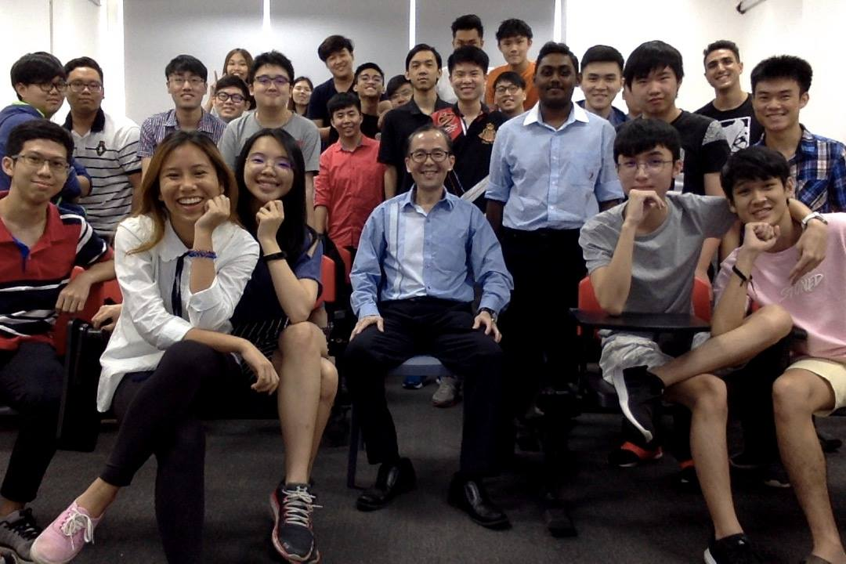
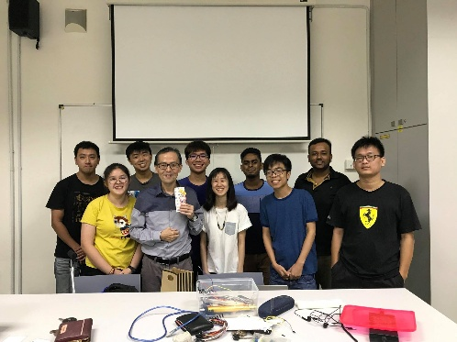
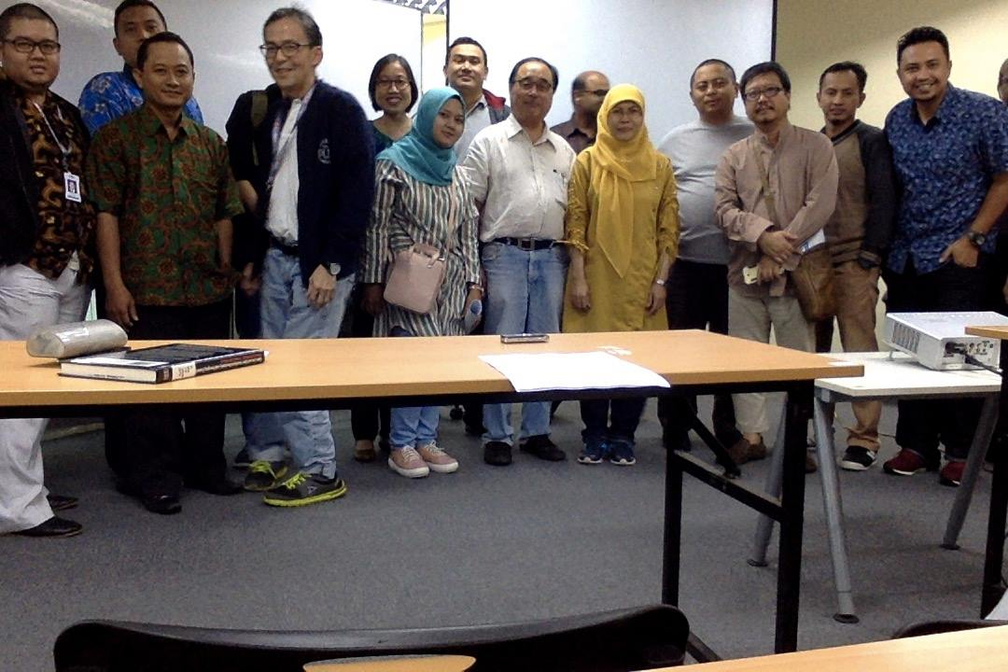
My background
Semi-Retired College lecturer & Cybersecurity Industry Trainer
PhD in Computer Science
More than 30 years’ experience teaching
Computer Science & IT

